Slide 1
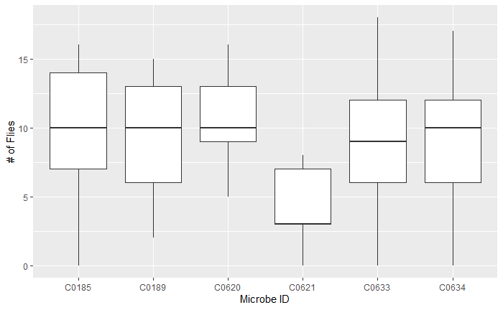

Slide 2
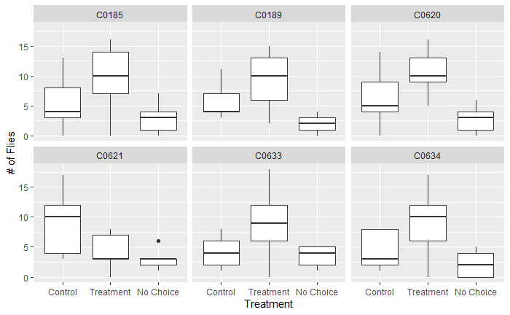

Slide 3
Call:
lm(formula = flies_in_treat ~ microbe, data = data)
Residuals:
Min 1Q Median 3Q Max
-9.8889 -2.8889 0.1111 3.1111 9.1111
Coefficients:
Estimate Std. Error t value Pr(>|t|)
(Intercept) 9.8889 1.5564 6.354 7.21e-08 ***
microbeC0189 -0.5556 2.2011 -0.252 0.8018
microbeC0620 1.0000 2.2011 0.454 0.6516
microbeC0621 -5.7778 2.2011 -2.625 0.0116 *
microbeC0633 -1.0000 2.2011 -0.454 0.6516
microbeC0634 -0.7778 2.2011 -0.353 0.7254
---
Signif. codes: 0 ‘***’ 0.001 ‘**’ 0.01 ‘*’ 0.05 ‘.’ 0.1 ‘ ’ 1
Residual standard error: 4.669 on 48 degrees of freedom
Multiple R-squared: 0.1933, Adjusted R-squared: 0.1093
F-statistic: 2.301 on 5 and 48 DF, p-value: 0.05933
hat values (leverages) are all = 0.1111111
and there are no factor predictors; no plot no. 5

Slide 4
Call:
lm(formula = observed ~ location, data = data0621)
Residuals:
Min 1Q Median 3Q Max
-5.7778 -1.4444 0.2222 2.0556 8.2222
Coefficients:
Estimate Std. Error t value Pr(>|t|)
(Intercept) 8.778 1.118 7.851 4.39e-08 ***
locationflies_in_treat -4.667 1.581 -2.951 0.006962 **
locationflies_outside -6.000 1.581 -3.795 0.000884 ***
---
Signif. codes: 0 ‘***’ 0.001 ‘**’ 0.01 ‘*’ 0.05 ‘.’ 0.1 ‘ ’ 1
Residual standard error: 3.354 on 24 degrees of freedom
Multiple R-squared: 0.3982, Adjusted R-squared: 0.3481
F-statistic: 7.941 on 2 and 24 DF, p-value: 0.002256
hat values (leverages) are all = 0.1111111
and there are no factor predictors; no plot no. 5

Slide 5
Call:
lm(formula = observed ~ location, data = data0620)
Residuals:
Min 1Q Median 3Q Max
-6.2222 -2.2222 -0.8889 1.8333 7.7778
Coefficients:
Estimate Std. Error t value Pr(>|t|)
(Intercept) 6.222 1.115 5.579 9.67e-06 ***
locationflies_in_treat 4.667 1.577 2.959 0.00684 **
locationflies_outside -3.778 1.577 -2.395 0.02477 *
---
Signif. codes: 0 ‘***’ 0.001 ‘**’ 0.01 ‘*’ 0.05 ‘.’ 0.1 ‘ ’ 1
Residual standard error: 3.346 on 24 degrees of freedom
Multiple R-squared: 0.5452, Adjusted R-squared: 0.5073
F-statistic: 14.39 on 2 and 24 DF, p-value: 7.831e-05
hat values (leverages) are all = 0.1111111
and there are no factor predictors; no plot no. 5

Slide 6
Call:
lm(formula = observed ~ location, data = data0633)
Residuals:
Min 1Q Median 3Q Max
-8.8889 -2.0556 0.1111 1.5556 9.1111
Coefficients:
Estimate Std. Error t value Pr(>|t|)
(Intercept) 4.2222 1.2222 3.455 0.00206 **
locationflies_in_treat 4.6667 1.7285 2.700 0.01251 *
locationflies_outside -0.7778 1.7285 -0.450 0.65677
---
Signif. codes: 0 ‘***’ 0.001 ‘**’ 0.01 ‘*’ 0.05 ‘.’ 0.1 ‘ ’ 1
Residual standard error: 3.667 on 24 degrees of freedom
Multiple R-squared: 0.326, Adjusted R-squared: 0.2698
F-statistic: 5.804 on 2 and 24 DF, p-value: 0.008787
hat values (leverages) are all = 0.1111111
and there are no factor predictors; no plot no. 5

Slide 7
Call:
lm(formula = observed ~ location, data = data0185)
Residuals:
Min 1Q Median 3Q Max
-9.889 -2.667 0.000 3.056 7.556
Coefficients:
Estimate Std. Error t value Pr(>|t|)
(Intercept) 5.444 1.429 3.810 0.000851 ***
locationflies_in_treat 4.444 2.021 2.199 0.037744 *
locationflies_outside -2.444 2.021 -1.210 0.238238
---
Signif. codes: 0 ‘***’ 0.001 ‘**’ 0.01 ‘*’ 0.05 ‘.’ 0.1 ‘ ’ 1
Residual standard error: 4.287 on 24 degrees of freedom
Multiple R-squared: 0.3323, Adjusted R-squared: 0.2767
F-statistic: 5.973 on 2 and 24 DF, p-value: 0.007849
hat values (leverages) are all = 0.1111111
and there are no factor predictors; no plot no. 5

Slide 8
Call:
lm(formula = observed ~ location, data = data0189)
Residuals:
Min 1Q Median 3Q Max
-7.333 -1.778 0.000 1.722 5.667
Coefficients:
Estimate Std. Error t value Pr(>|t|)
(Intercept) 5.556 1.005 5.527 1.1e-05 ***
locationflies_in_treat 3.778 1.421 2.658 0.0138 *
locationflies_outside -3.556 1.421 -2.501 0.0196 *
---
Signif. codes: 0 ‘***’ 0.001 ‘**’ 0.01 ‘*’ 0.05 ‘.’ 0.1 ‘ ’ 1
Residual standard error: 3.015 on 24 degrees of freedom
Multiple R-squared: 0.5259, Adjusted R-squared: 0.4864
F-statistic: 13.31 on 2 and 24 DF, p-value: 0.0001289
hat values (leverages) are all = 0.1111111
and there are no factor predictors; no plot no. 5

Slide 9
Call:
lm(formula = observed ~ location, data = data0634)
Residuals:
Min 1Q Median 3Q Max
-9.1111 -2.2222 -0.2222 2.8333 7.8889
Coefficients:
Estimate Std. Error t value Pr(>|t|)
(Intercept) 4.222 1.269 3.326 0.00282 **
locationflies_in_treat 4.889 1.795 2.724 0.01185 *
locationflies_outside -2.000 1.795 -1.114 0.27624
---
Signif. codes: 0 ‘***’ 0.001 ‘**’ 0.01 ‘*’ 0.05 ‘.’ 0.1 ‘ ’ 1
Residual standard error: 3.808 on 24 degrees of freedom
Multiple R-squared: 0.3938, Adjusted R-squared: 0.3433
F-statistic: 7.796 on 2 and 24 DF, p-value: 0.002462
hat values (leverages) are all = 0.1111111
and there are no factor predictors; no plot no. 5

